Slide 1

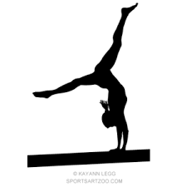

2026 MARCH
MADNESS
Gymnastics meet 3/7/2026-3/8/2026
Schedule of events
Saturday, March 7, 2026
Sunday, March 8, 2026
Session 1
Level 4 (DOB 3/14/2015 or younger)/Xcel Gold
8:00 AM Open Stretch
Session 5
Level 3
8:00 AM Open Stretch
Session 2
Level 4 (DOB 3/10/2015 or Older)/Level 5
11:30 AM Open Stretch
Session 6
Level 2/Xcel Bronze
11:30 AM Open Stretch
Session 3
Level 6/Level 7
3:15 PM Open Stretch
Session 7
Xcel Silver
2:00 PM Open Stretch
Session 4
Level 8, 9, and 10/ Xcel Platinum/Xcel Diamond
6:15 PM Open Stretch
Admission $5.00 per person
Parking – Please avoid parking in front of Pastaggio’s Restaurant and in front of garage doors at mechanic shop directly across the street
Elevate Gymnastics and Athletics
3030 Harrelson St
Las Cruces, NM 88005
575-524-4960
www.elevate-gymnastics.com

